Slide 1
Blog posting website
CoursE CodE: CsE326
CoursE titlE: intErnEt Programming laboratory ProJECt rEPort
SUBMITTED BY:
SUBMITTED TO: Dr. Pushpender (Professor)
In partial fulfillment for the requirement of the award of degree of B Tech (Computer Science Engineering)
Name | Roll No. | Reg. No
BIBEK BAYAN | 19 | 12400435

Slide 2

Lovely Professional University
Phagwara, Punjab

Slide 3
CONTENT TABLE:
SL NO. | CONTENT | PAGE NO.
1 | PARTICULARS | 1
2 | INTRODUCTION | 4
3 | METHODOLOGY | 5
4 | TECHNOLOGIES | 6-7
5 | WEBSITE SANPSHOTS | 8-10
6 | CONCLUSION | 11
7 | REFERENCES | 12

Slide 4
INTRODUCTION
Greetings from ‘Rubik Blog’, a prestigious site dedicated to finding and disseminating the most fascinating and educational information from a global perspective. Our goal is to give readers well-researched, factual, and interesting information covering a wide range of topics. From historical occurrences to scientific breakthroughs, and from cultural phenomena to current concerns, ‘Rubik Blog’ is a vast knowledge base that aims to inform and motivate its readers. Come explore the wonders of the world with us, one fact at a time.

Slide 5
METHODOLOGY
The project was developed using HTML for the structure, CSS for styling. The development of this project followed a streamlined approach, combining content structuring, responsive design, visual engagement, and user interaction to create an effective educational platform. This website was designed to ensure that “Rubik Blogs" achieves its primary objective of being an accessible, visually pleasing, and user-focused Blog - Platform centered around factual
Information covering a wide range of topics.

Slide 6
Building a website for Blog posting
Platform: Technologies Used:
HTML: - The backbone of the project, HTML was used to structure and organize the content. It facilitated the creation of essential elements like headers, paragraphs, links, and multimedia embedding.
CSS: - CSS was employed extensively for styling and layout purposes. It dictated the project's visual aesthetics, including color schemes, font styles, responsive design, and animation effects like the dynamic rainbow background.
Media Integration: - Images and embedded videos were seamlessly incorporated into the content using HTML and CSS. This enhances the overall learning experience by providing visual elements to support the educational material.

Slide 7
4. Responsive Design: -
Media queries in CSS were utilized for responsive design, ensuring the project's adaptability across a variety of devices. This enhances accessibility and usability for users accessing the platform from different screens.
6. Testing Tools: -
Standard web browser developer tools were likely used for testing and debugging during the development phase. This ensures that the project functions as intended across different browsers and devices. By leveraging these technologies, including HTML for content structure, CSS for styling and layout, and potentially JavaScript for enhanced interactivity, you've created a comprehensive educational platform encompassing the home page, login page, and course contents. This combination provides a solid foundation for a user- friendly and visually engaging learning experience.

Slide 8
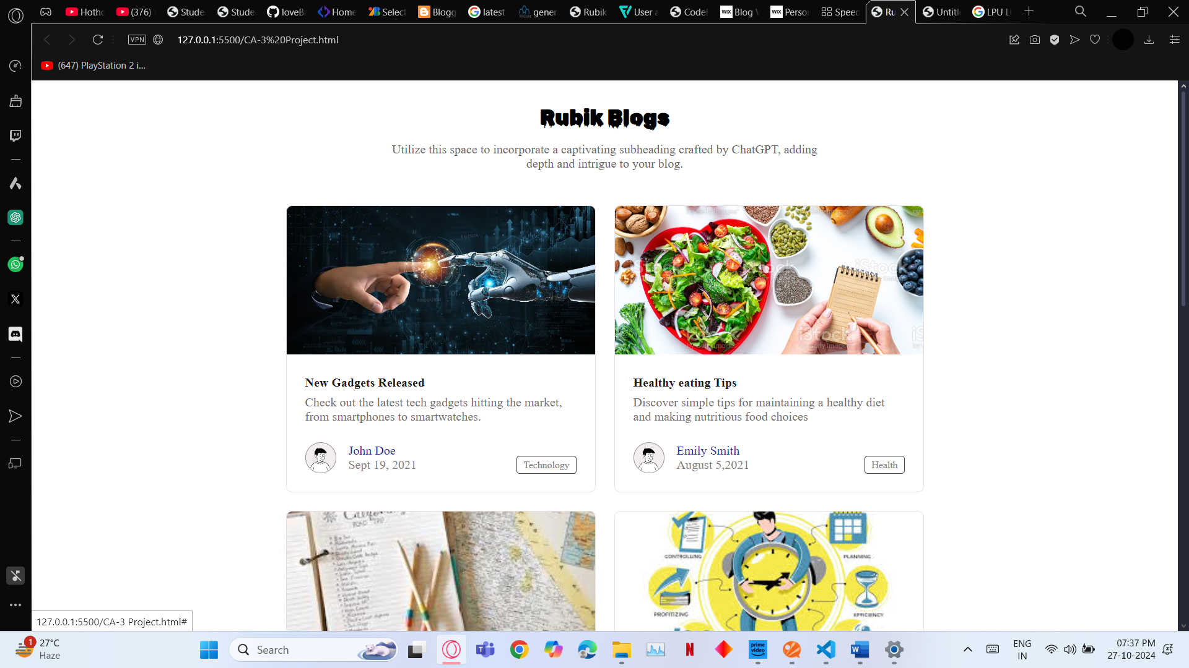
SCREENSHOTS:

Slide 9
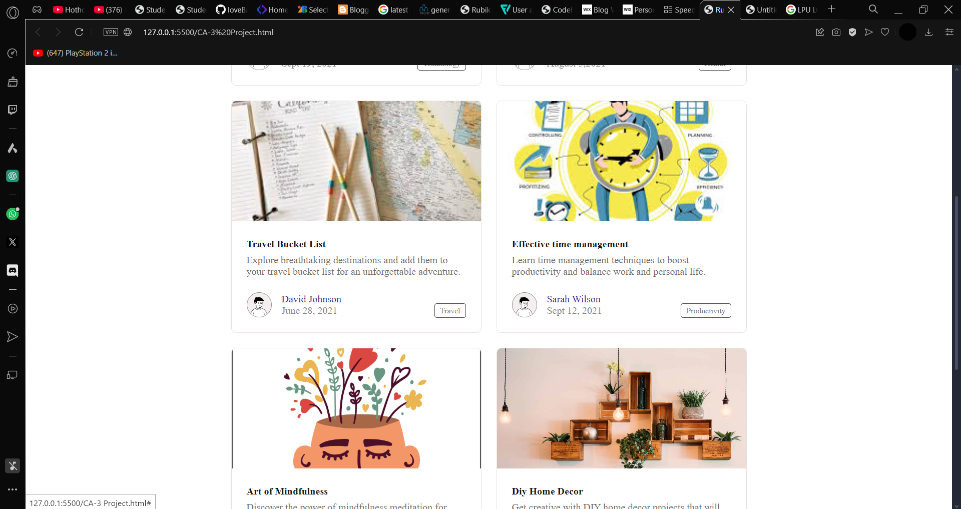

Slide 10
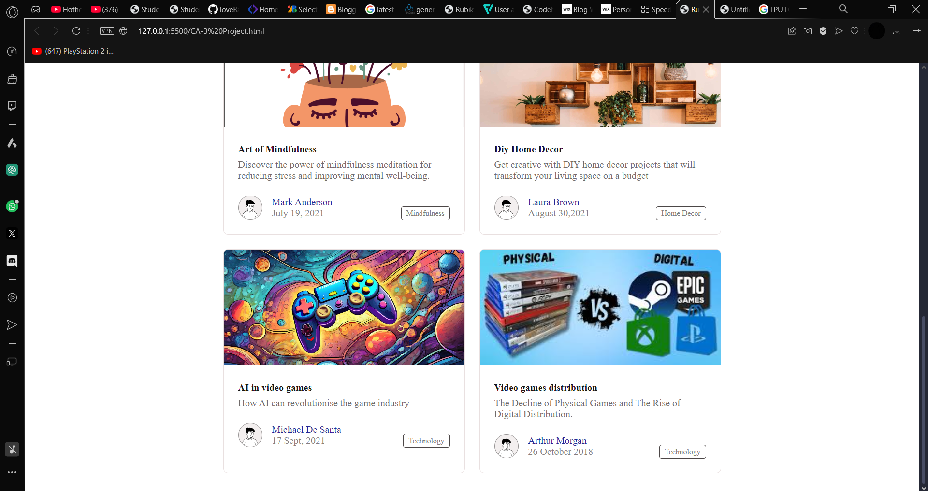

Slide 11
Conclusion:
The website is a Blog posting website made with HTML code,CSS,media integration,Responsive Design,HyperLinks and Navigations Testing tools. The main purpose is to serve as a premier platform for uncovering and sharing the most intriguing and enlightening facts from around the globe. We hope to promote a greater awareness and admiration of the wonders of the world by offering carefully considered, factual, and captivating content.

Slide 12
References:
https://www.w3schools.com/
https://freecodecamp.com/

